Slide 1

Amazon Sales Analysis
USING PYTHON
Navin Singh

Slide 2

INTRODUCTION
A comprehensive analysis of Amazon sales data, identifying key metrics and factors. This study showcases meaningful relationships between attributes such as Year, Month, Sales Channel, Order Priority, and Region with metrics like Sales, Profit, Cost, and Order Distribution.

Slide 3
Table of contents
Key Performance Indicators Order Priority based Analysis Year-month Trends Item Type Breakdown Analysis Sales Channel wise Overview Regional Insights Country Comparison
01 - 02 - 03 - 04 - 05 - 06 – 07 -

Slide 4

01
Key Performance Indicators

Slide 5
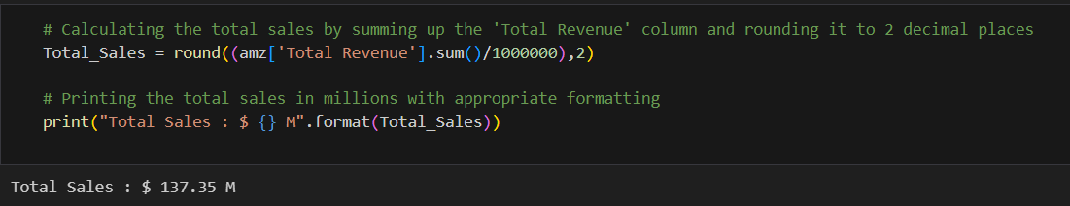
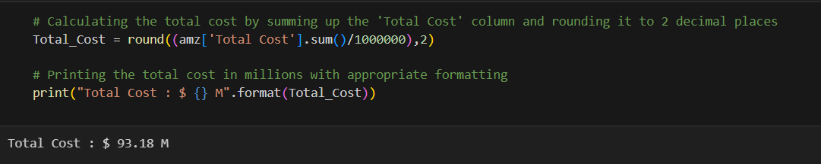
Total Sales & Total Cost

Slide 6
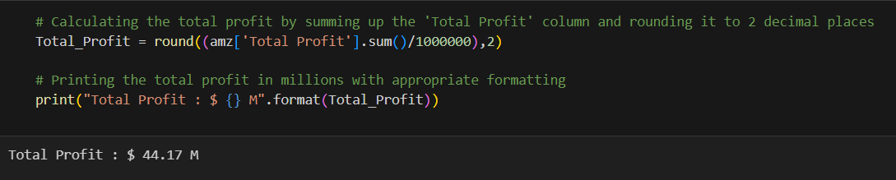
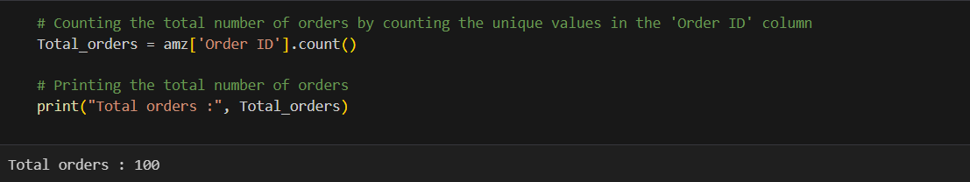
Total Profit & Total Orders

Slide 7

02
Order Priority based Analysis

Slide 8
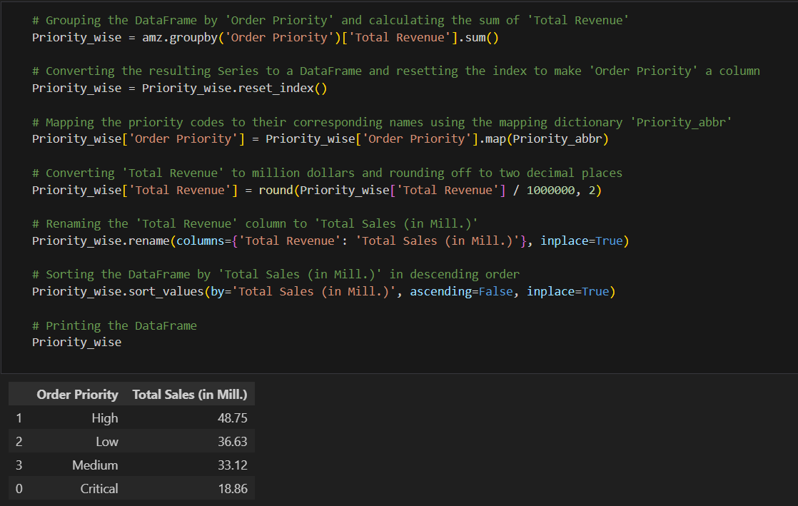
Order Priority wise Sales

Slide 9
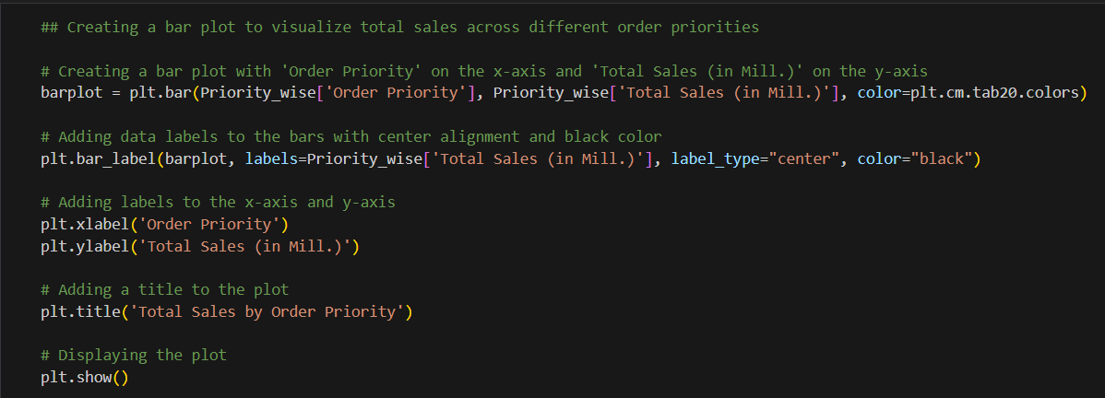
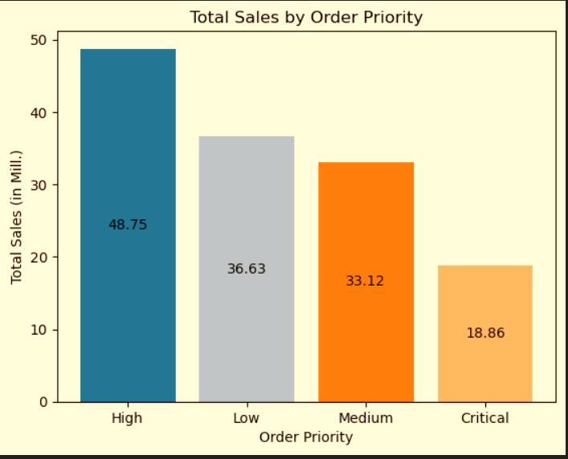
Visualizing Order Priority wise Sales

Slide 10
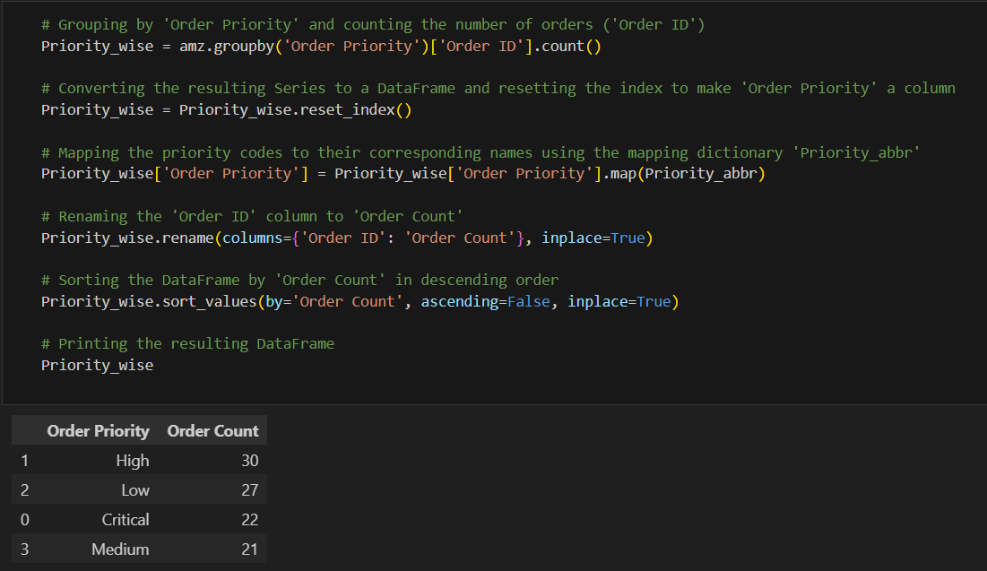
Order Priority wise Order Distribution

Slide 11
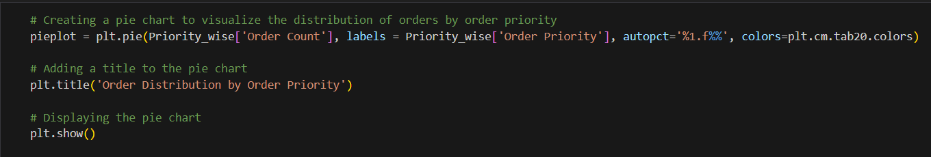
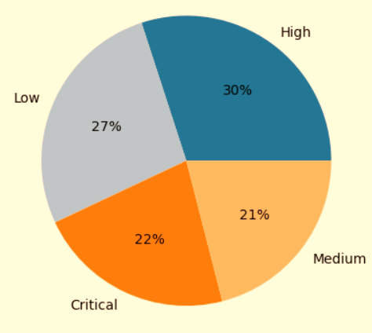
Visualizing Order Priority wise Order Distribution

Slide 12

03
Year, Month & Year-month Trends

Slide 13
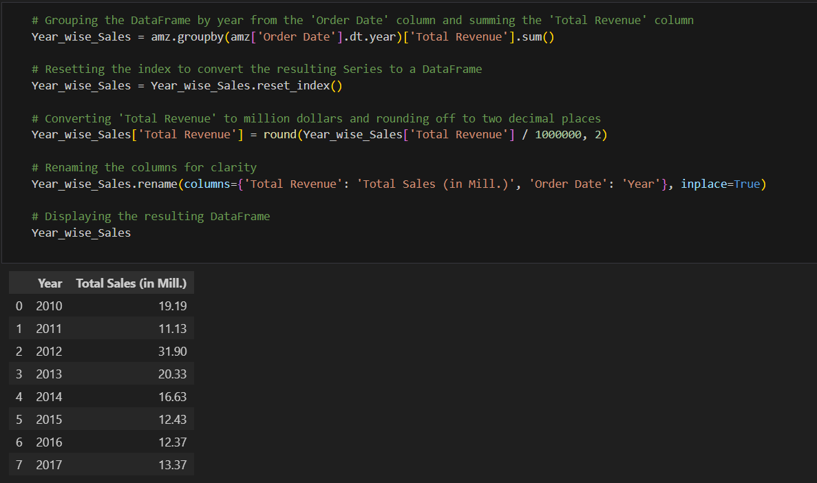
Year wise Sales

Slide 14
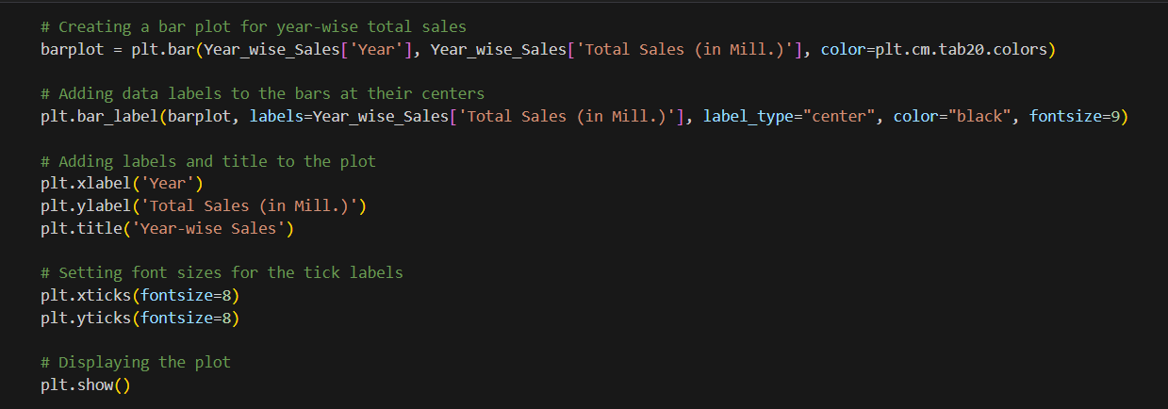
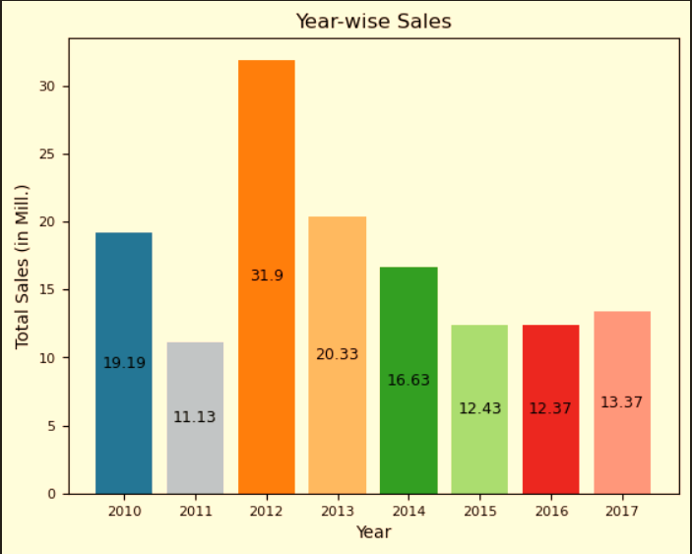
Visualizing Year wise Sales

Slide 15
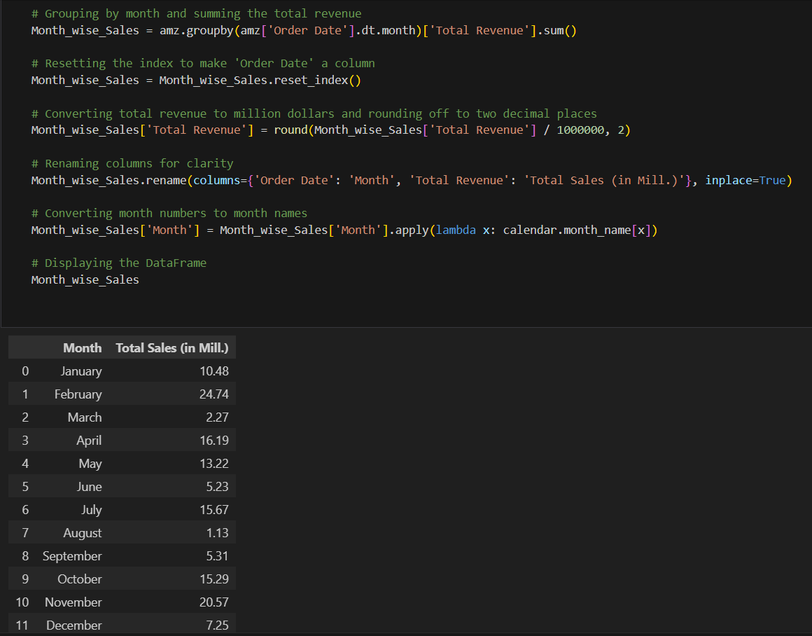
Month wise Sales

Slide 16
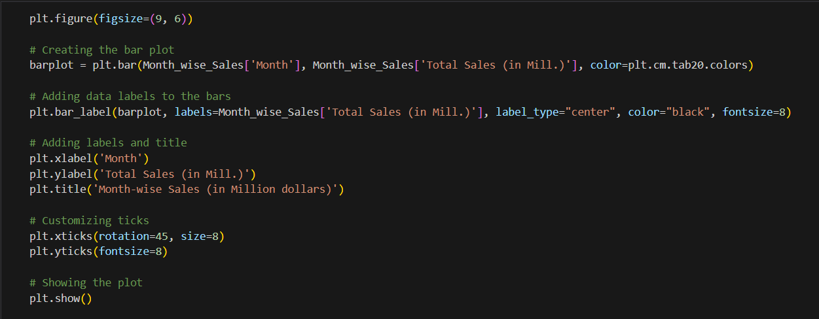
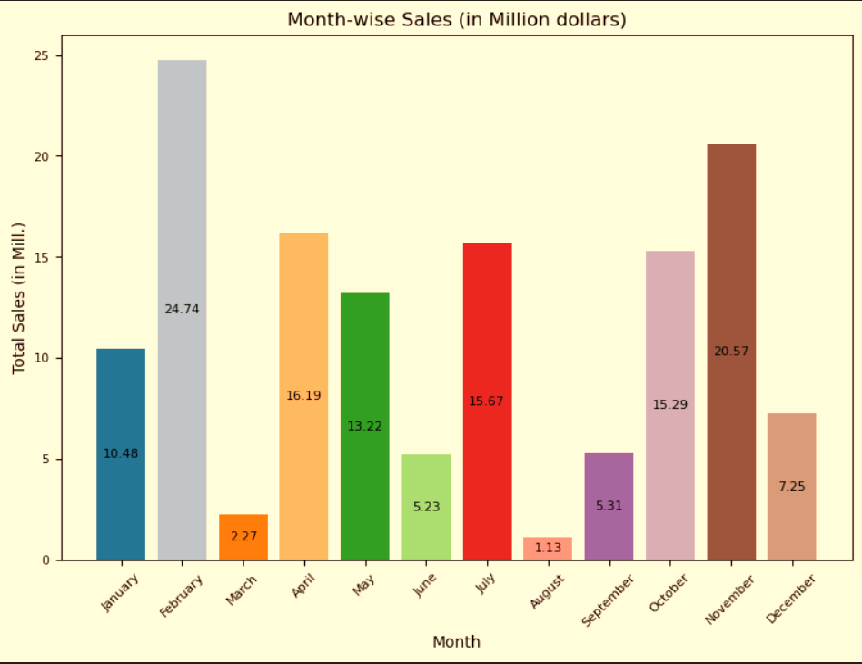
Visualizing Month wise Sales

Slide 17

04
Item Type Breakdown Analysis

Slide 18
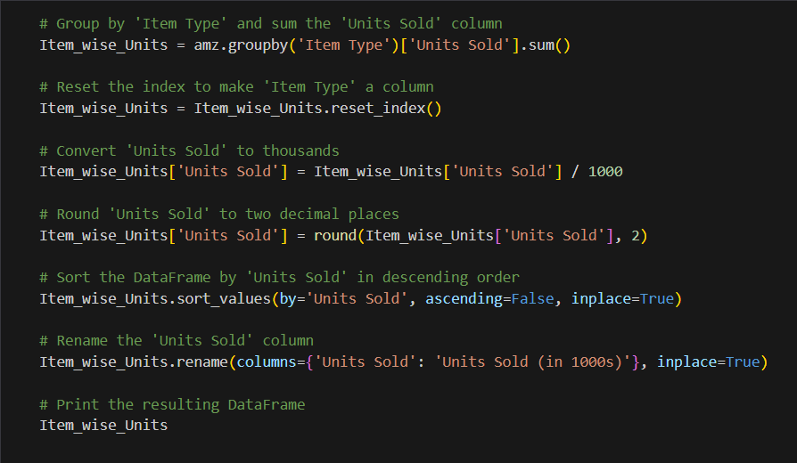
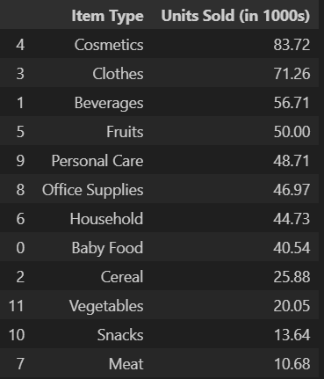
Item type wise Units Sold

Slide 19
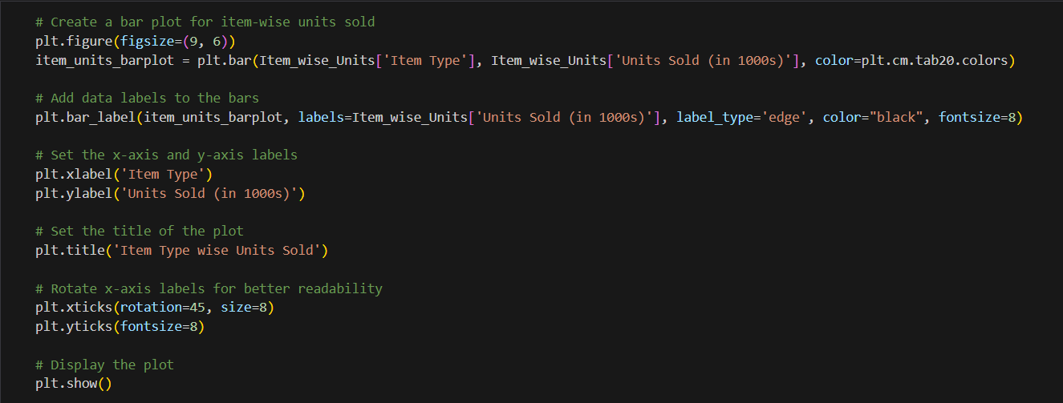
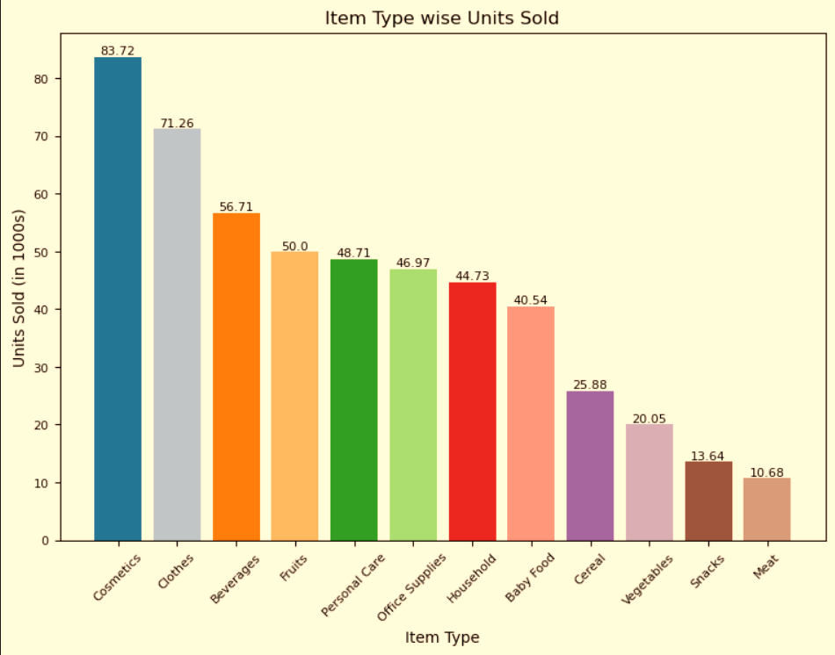
Visualizing Item type wise Units Sold

Slide 20
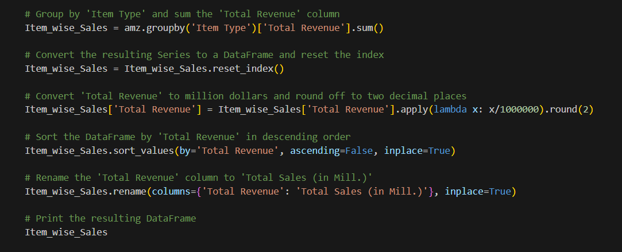
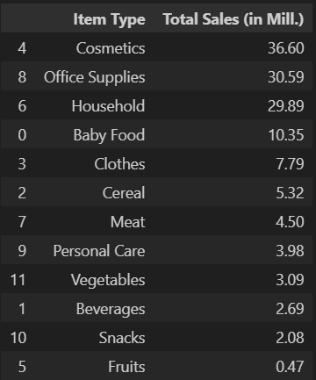
Item type wise Sales

Slide 21
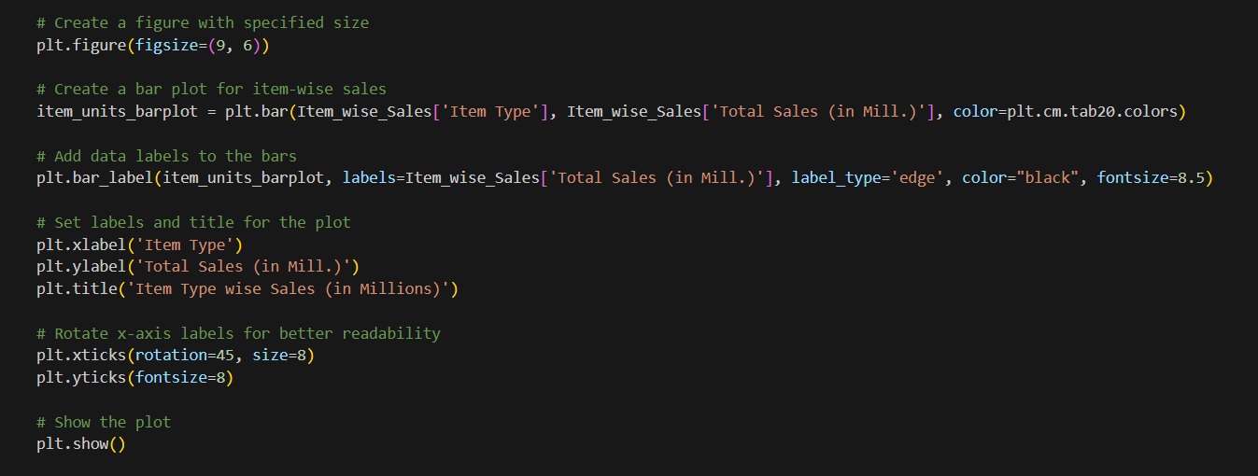
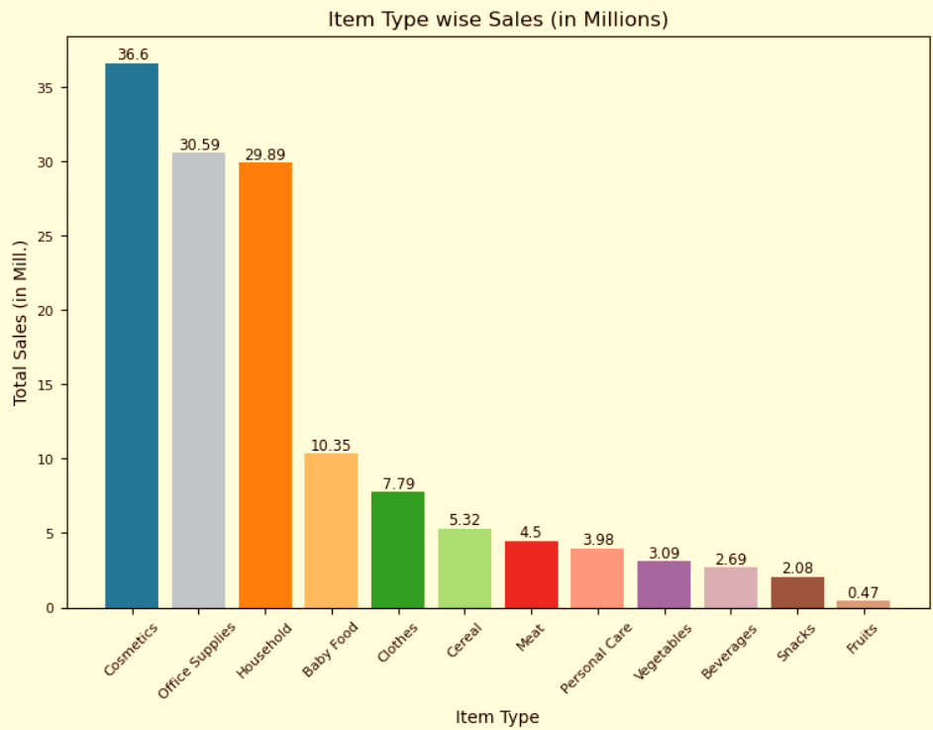
Visualizing Item type wise Sales

Slide 22
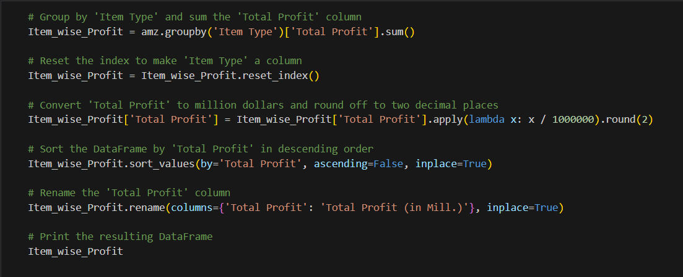
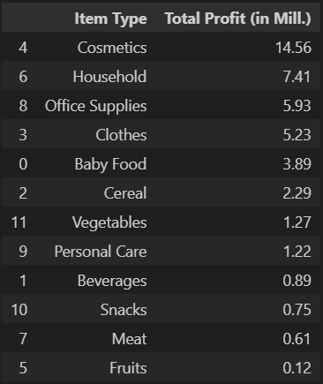
Item type wise Profit

Slide 23
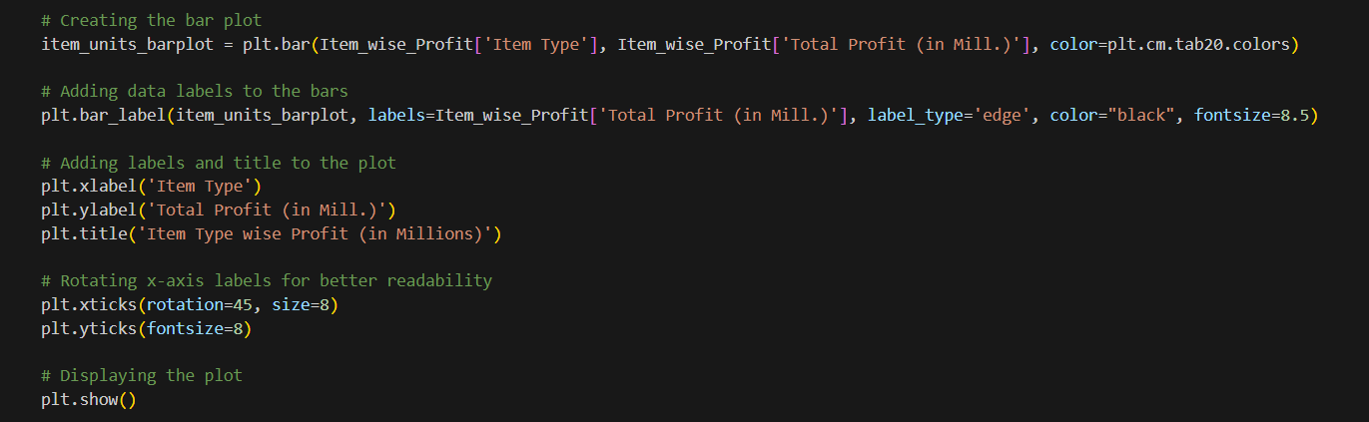
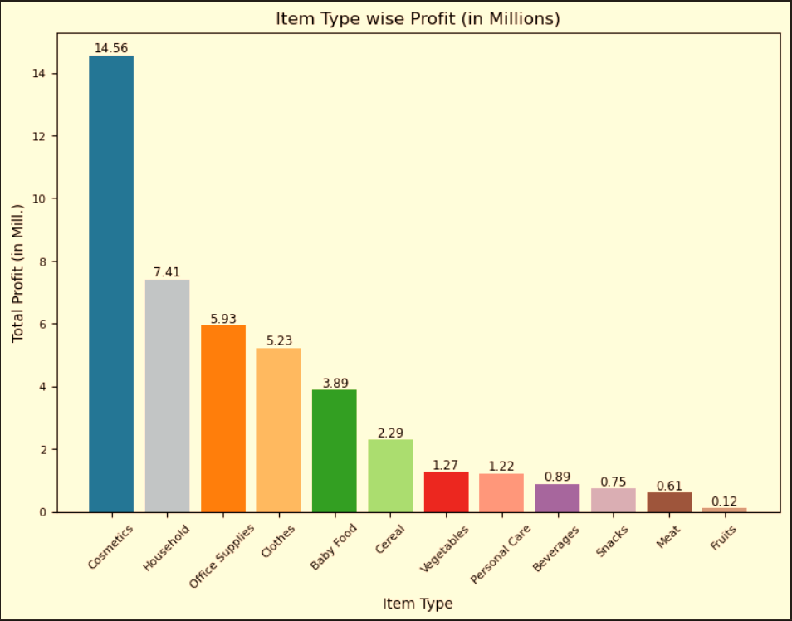
Visualizing Item type wise Profit

Slide 24
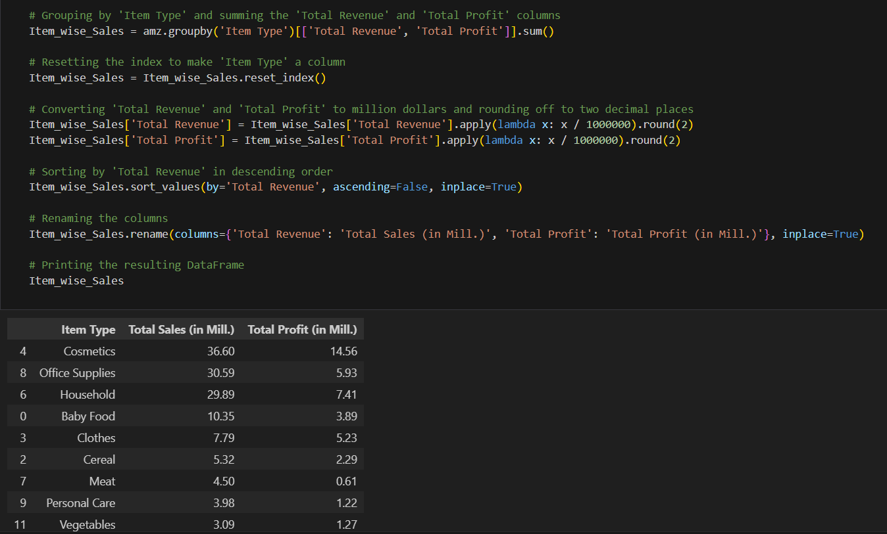
Item type wise Sales & Profit

Slide 25
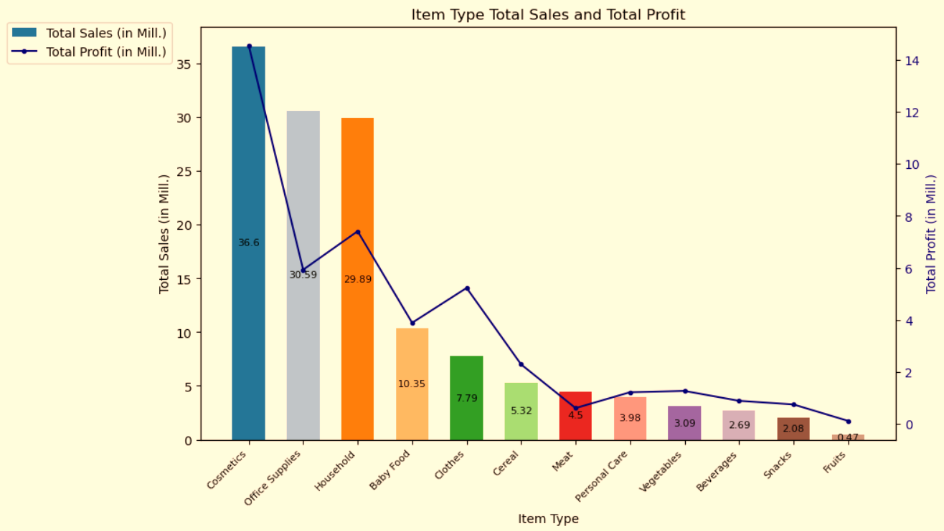
Visualizing Item type wise Sales & Profit

Slide 26

05
Sales Channel wise Overview

Slide 27
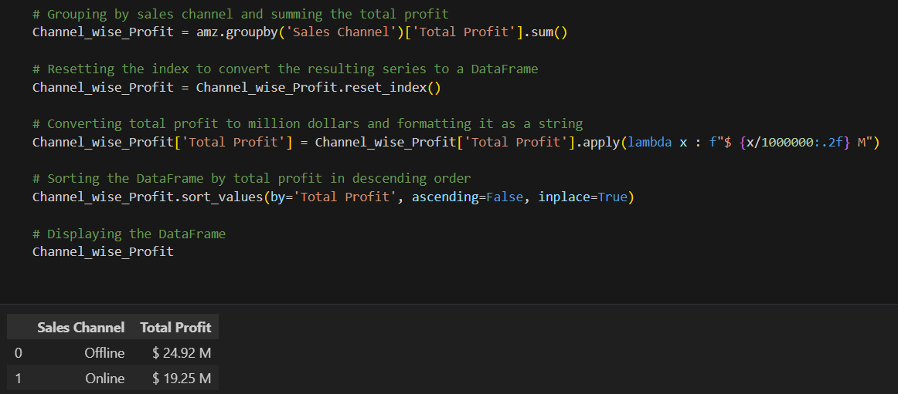
Sales Channel wise Profit

Slide 28
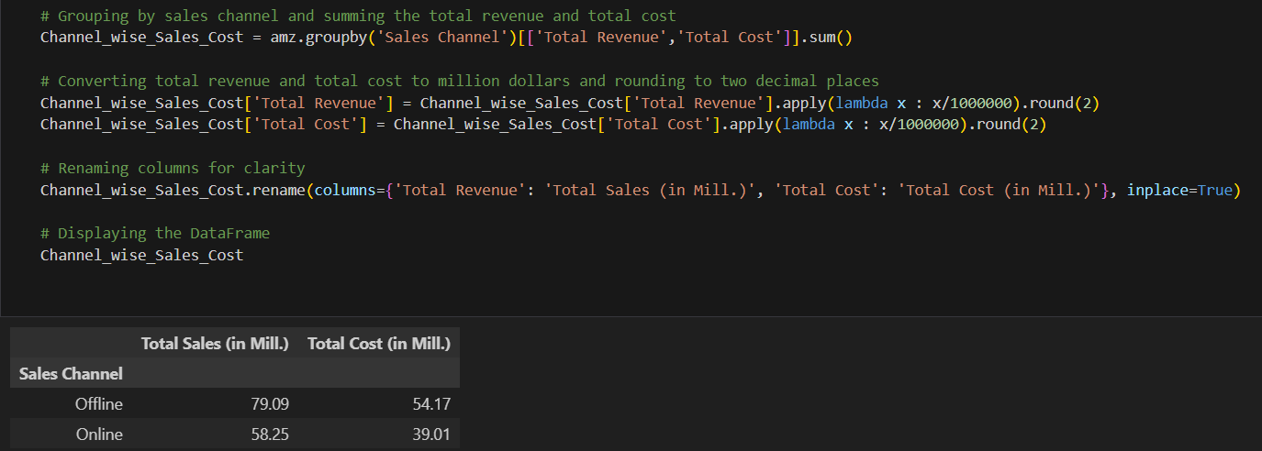
Sales Channel wise Sales & Cost

Slide 29
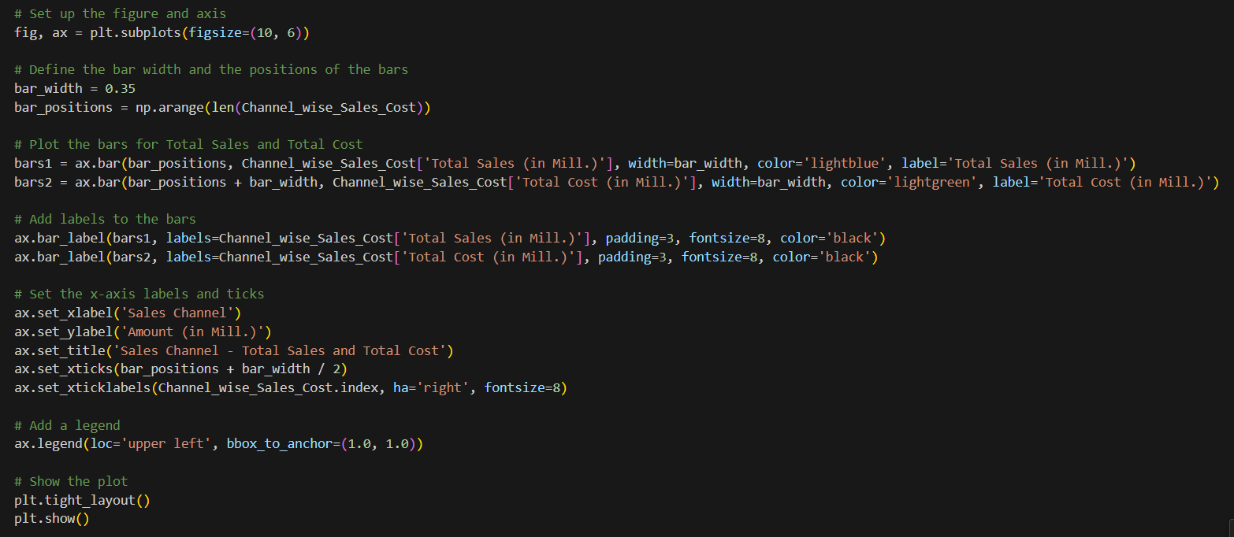
Visualizing Sales Channel wise Sales & Cost

Slide 30
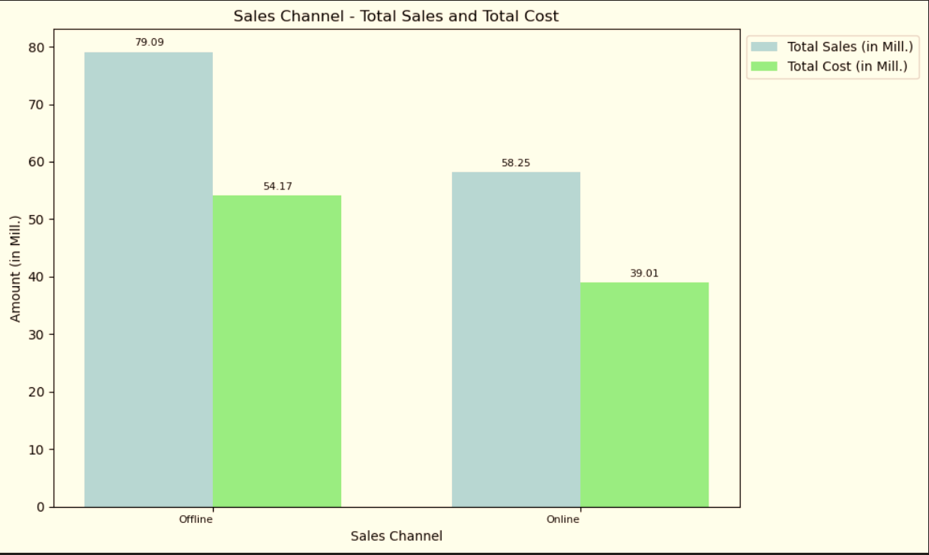
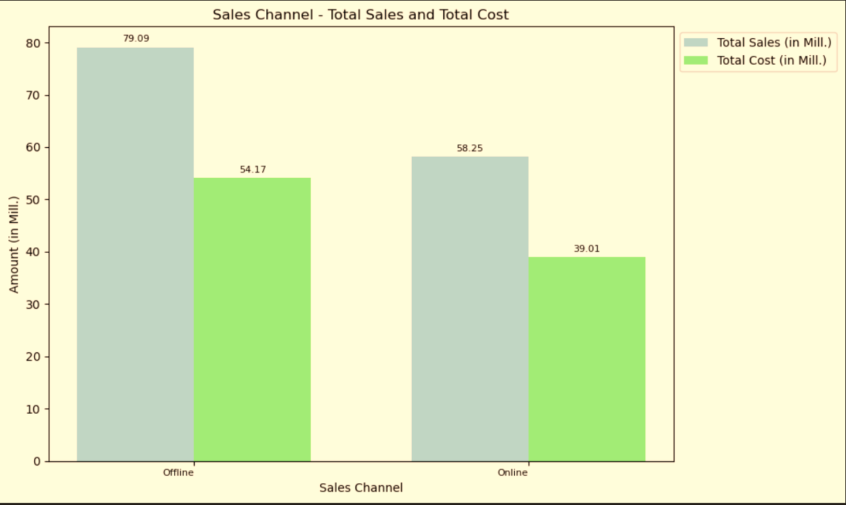
Visualizing Sales Channel wise Sales & Cost

Slide 31
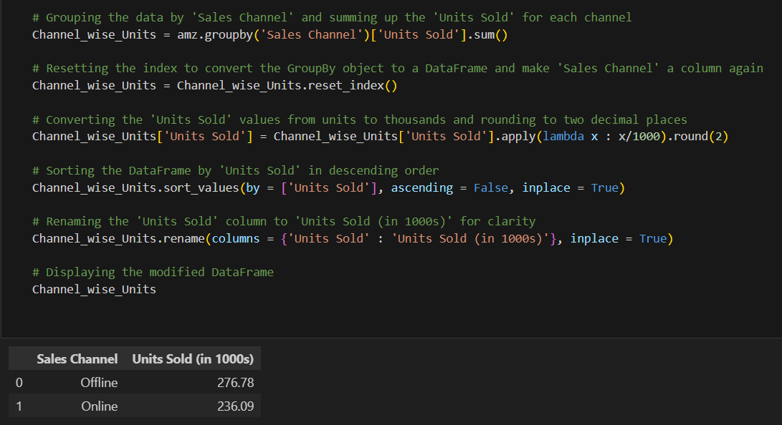
Sales Channel wise Units Sold

Slide 32
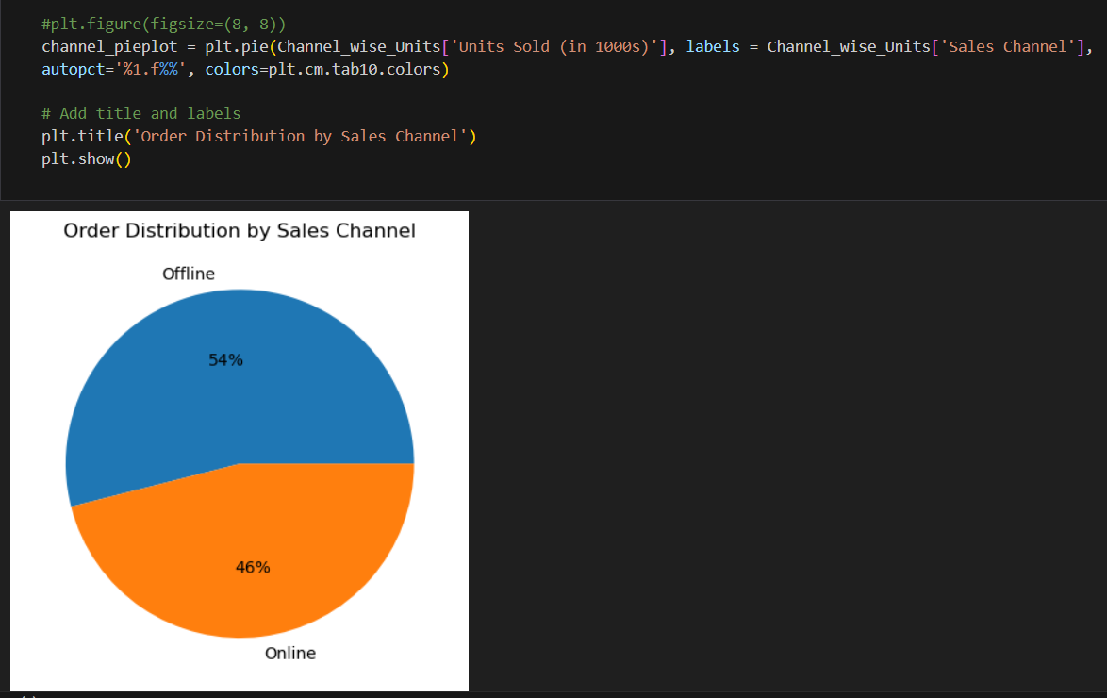
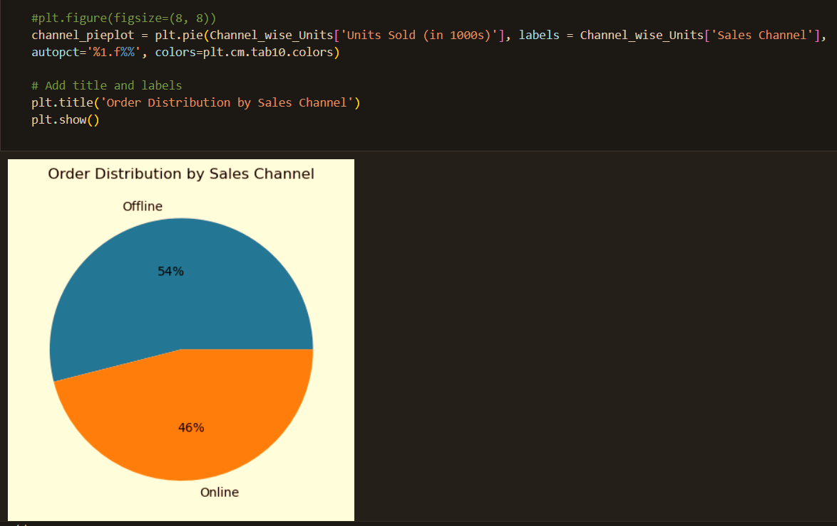
Visualizing Sales Channel wise Units Sold

Slide 33

06
Regional Insights

Slide 34
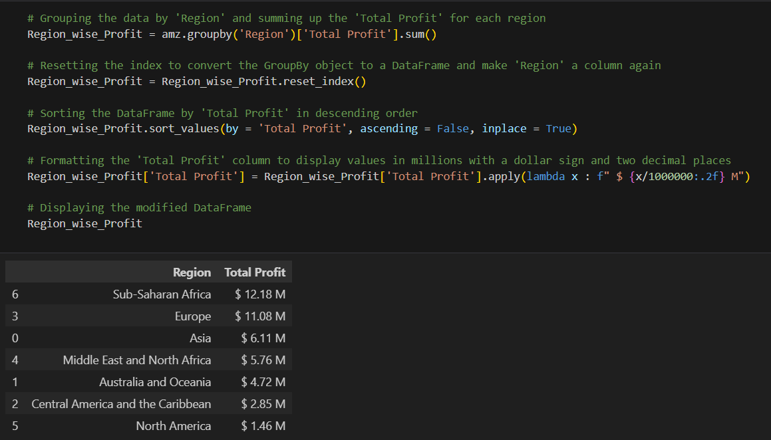
Region wise Profit

Slide 35
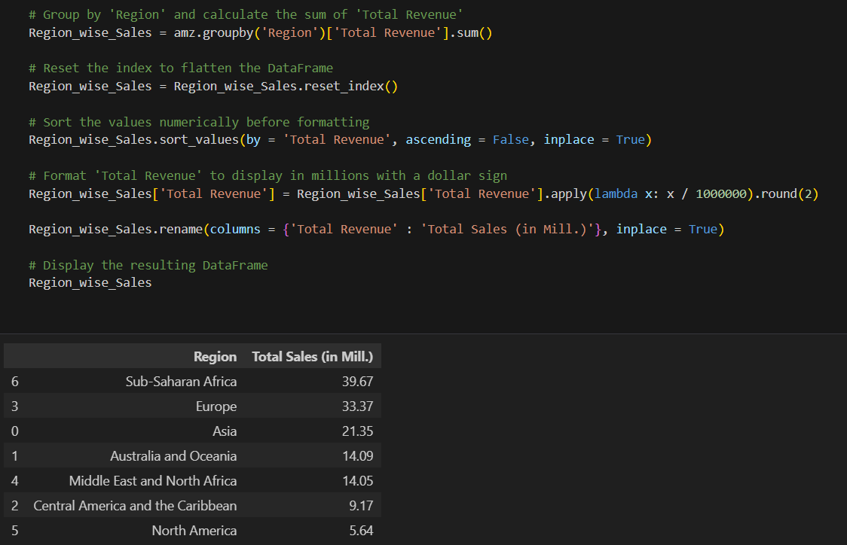
Region wise Sales

Slide 36
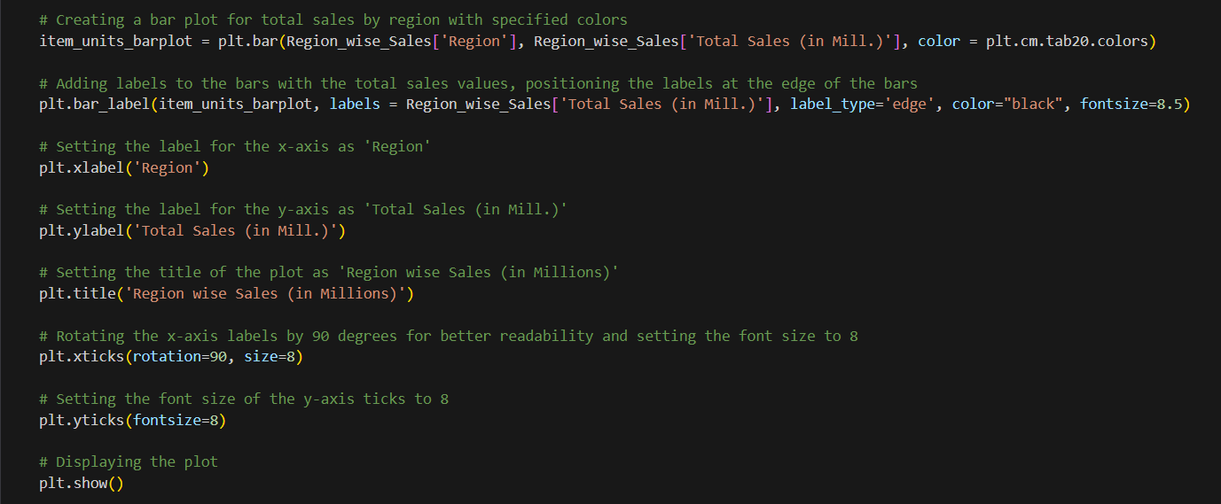
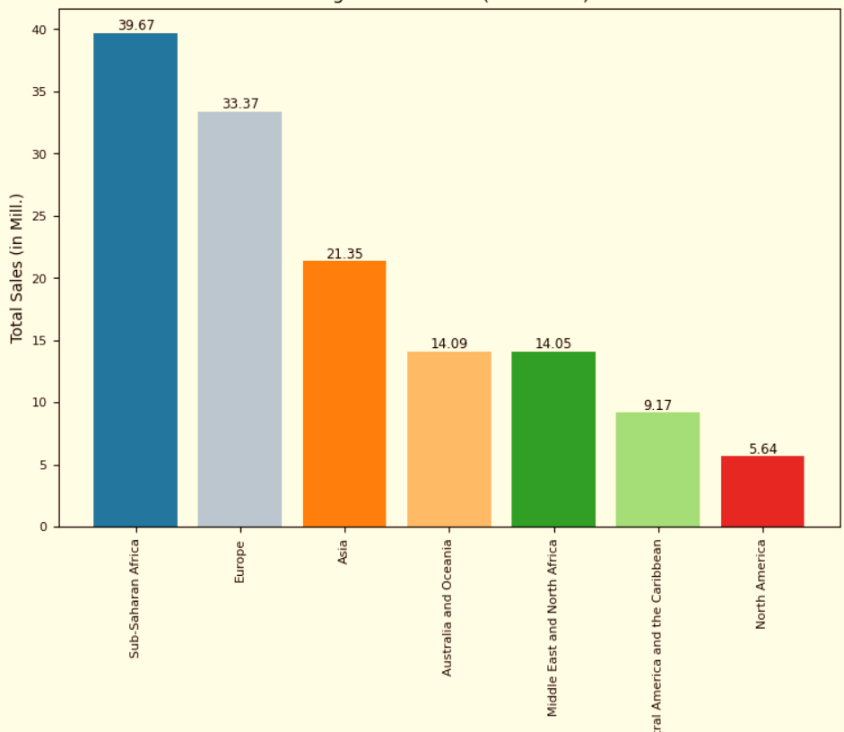
Visualizing Region wise Sales

Slide 37
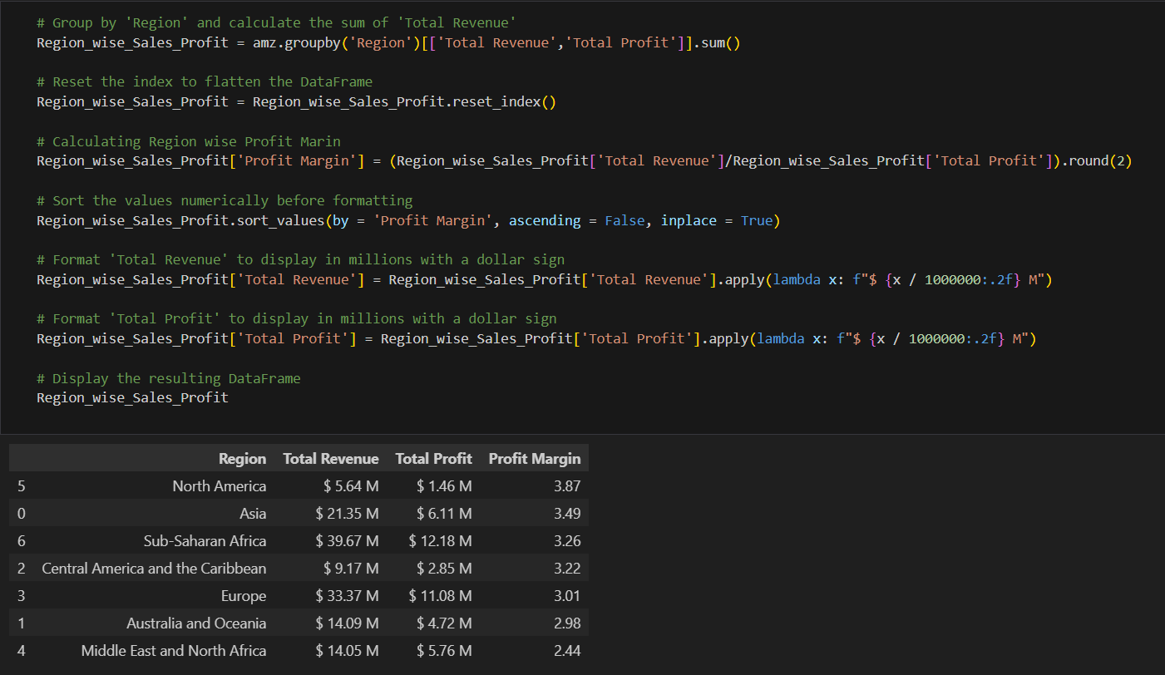
Region wise Sales & Profit

Slide 38
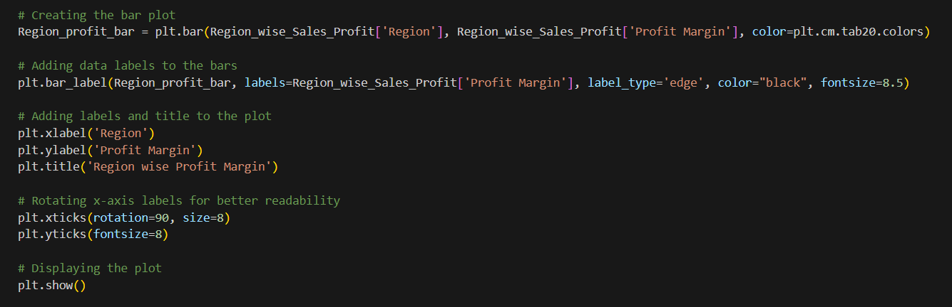
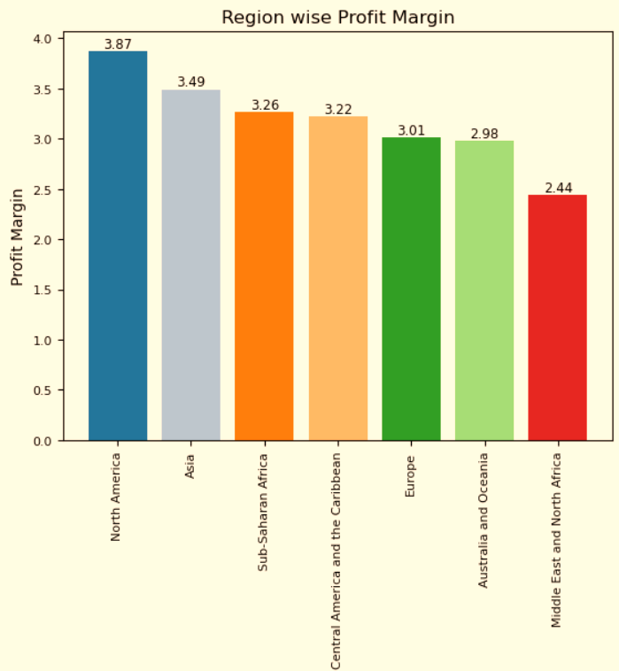
Visualizing Region wise Sales & Profit

Slide 39
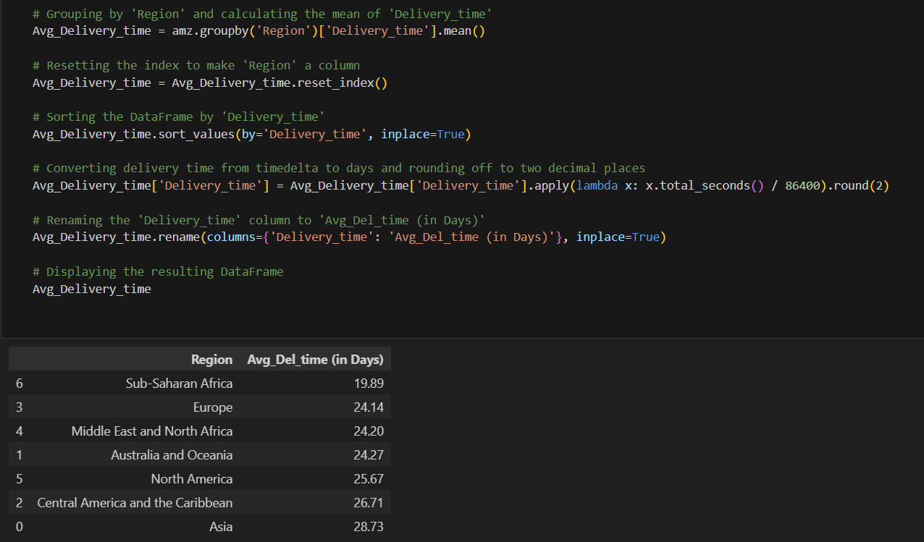
Region wise Average Delivery Time

Slide 40
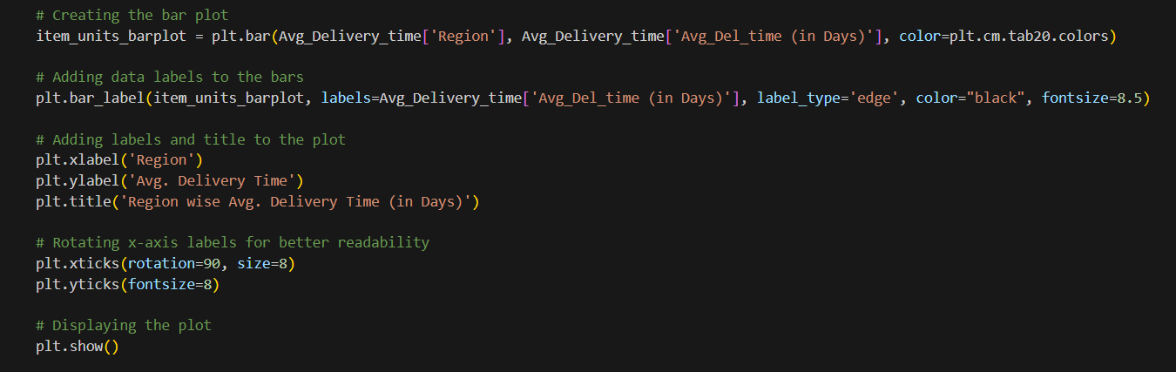
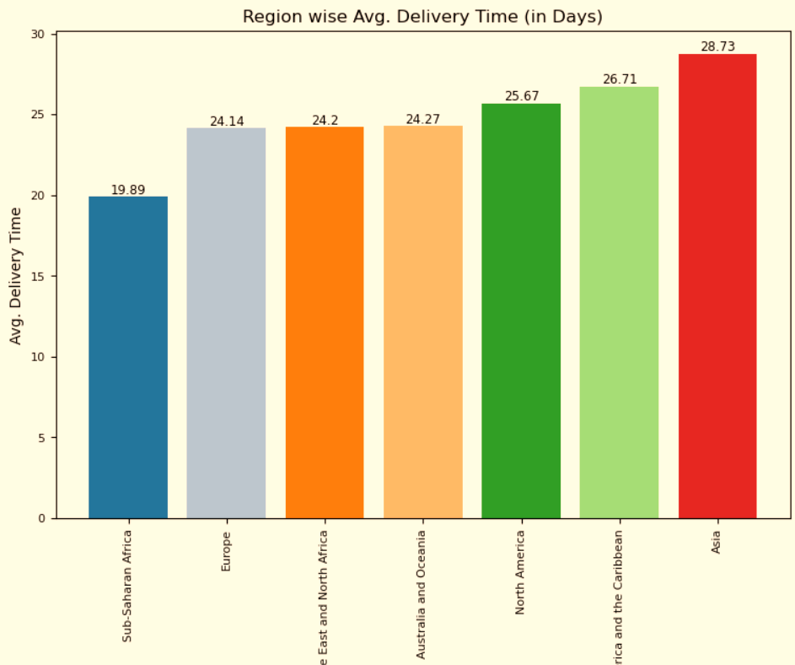
Visualizing Region wise Average Delivery Time

Slide 41

07
Country Comparison

Slide 42
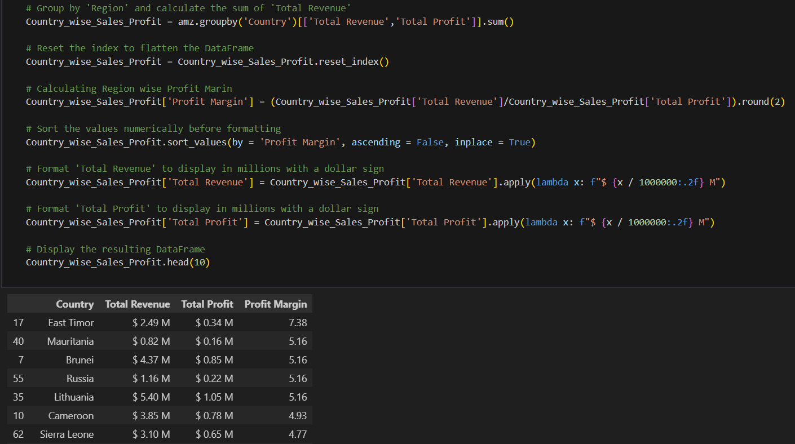
Country wise Sales, Profit & Profit Margin

Slide 43
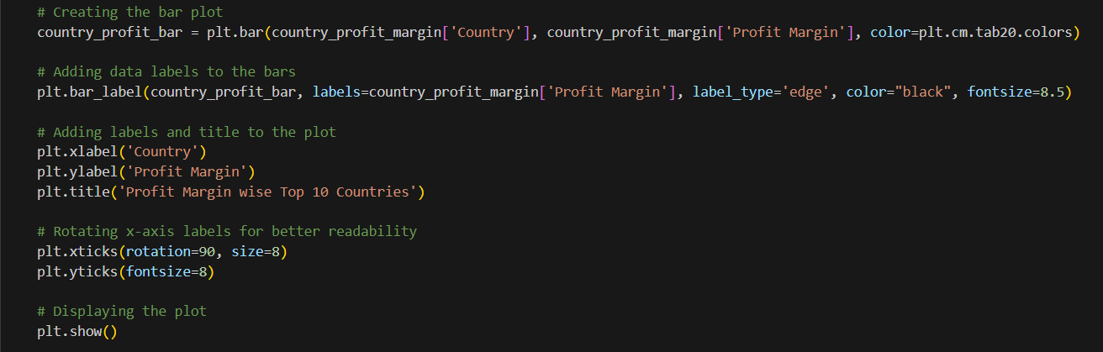

Top 10 Countries based on Profit Margin

Slide 44

Bottom 10 Countries based on Profit Margin

Slide 45
THANK YOU!
Navin Singh

